Slide 1
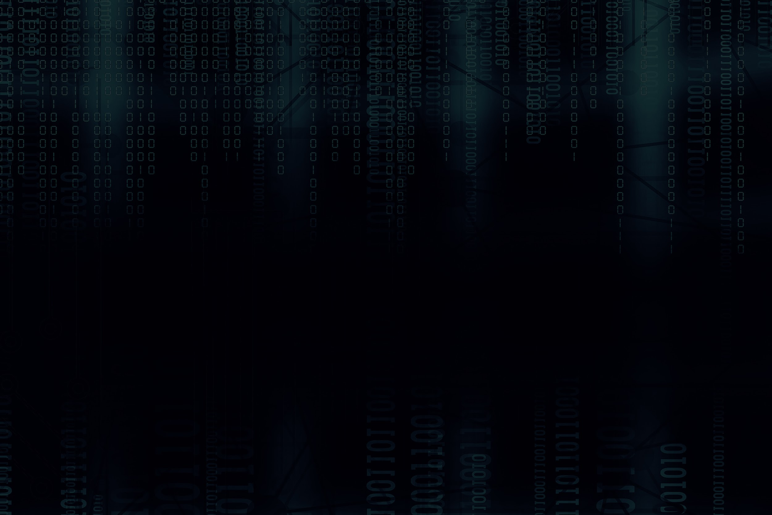


DATABASE_SECURITY & PRIVACY_PRESERVING TECHNOLOGIES
UNIVERSITY OF SOUTHERN MAINE - COS 457

Slide 2




MEET OUR AWESOME TEAM
Aubin Mugisha
Yunlong Li
Nikki Gorski
Kristina Zbinden
Sarah Kayembe

Slide 3
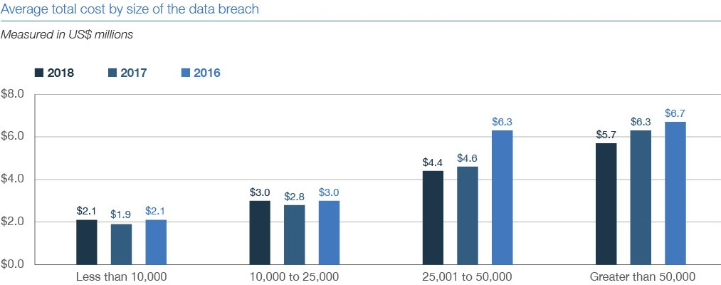
Motivations
Sensitive Information at Risk
Financial records
Medical data
Personal Identifiable Information (PII)
Legal Responsibility
HIPAA
FERPA
GDPR
CCPA
Consequences of Breaches
Financial loss-avg of $3.86 million per breach
Reputational damage
Loss of customer trust

Slide 4
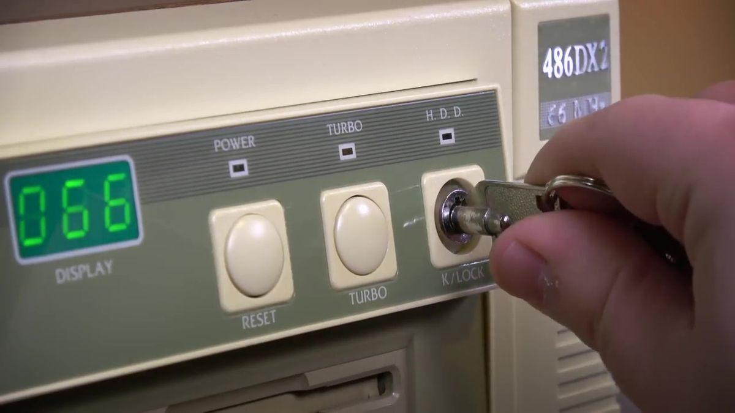
Early History (1960s-1980s)
Database Security Origins
Used mainly in government & military
Security = basic authentication + physical access control
  Locked server rooms
  Physical keys
Early Models of Confidentiality
  Information security mindset: "classified vs unclassified"

Slide 5
Early History (1960s-1980s)
Bell–LaPadula & Access Control Models (1973)Discretionary access control
divides entities into Discretionary access control
  Subjects: users, processes
  Objects: files, directories, ports
Multi-level security (MLS)
Rules
  Mandatory access control(MAC)
    Simple Security Property (no read up)
    *-Property (no write down)
  Discretionary access control(DAC)
    Discretionary Security Property (access matrix)

Slide 6
Commercial Databases & the 1990s Evolution
Role-Based Access Control (RBAC) (1977)
  introduction of private-public keys instead of just a single key
Expansion of encryption
  RSA(Rivest, Shamir, and Adleman)(Rivest, Shamir, and Adleman)
  DES (Data encryption standard) (1977)
    later became AES (2001)
    Government introduced encryption standard
Early auditing/logging
  Audit trails for recovery and misuse detection

Slide 7
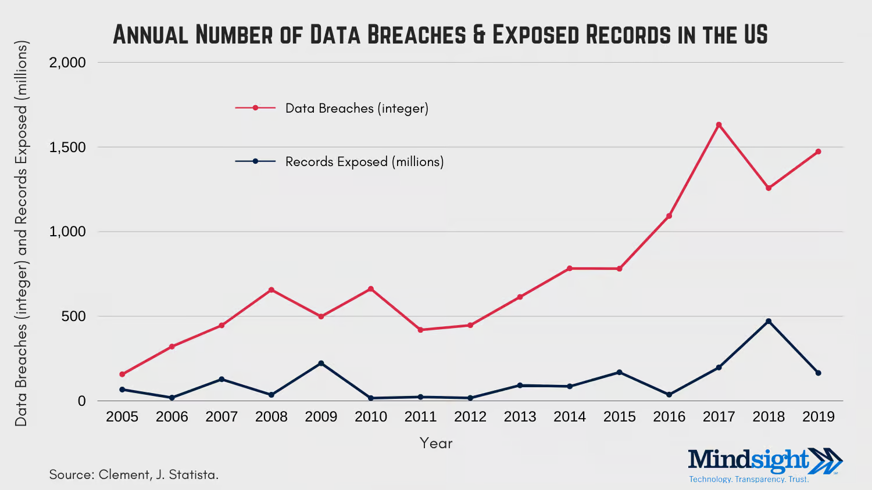
The 2000s: The Breach Era
Massive Growth in Breaches
  157 breaches (2005) → 662 (2010) → 3500+ (2023)
  ChoicePoint (2005, 2008)
  TJX/TJMaxx (2007): 45.7M credit cards stolen
SQL Injection Becomes a Major Threat
  Attackers inject malicious SQL
  Dump entire DB contents
Security Research Expands
  Database firewalls
  Intrusion Detection Systems (IDS)
    Network, Host, Signature-based, Anomaly-based
Stronger key management practices

Slide 8
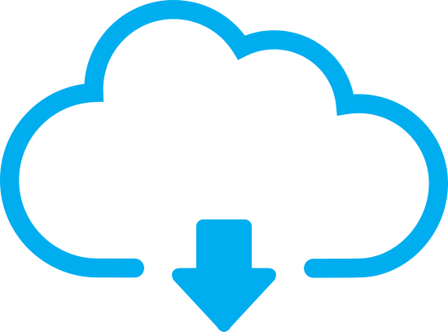
2010s: Privacy-Preserving Computation
Modern Privacy Threats
  Cloud computing
  Data reidentification risks
  Adversarial AI & reconstruction attacks
Key Technologies
  Homomorphic Encryption (compute on encrypted data)
  Differential Privacy (noise added to prevent re-ID)
  Secure Multi-Party Computation (joint computation without sharing inputs)

Slide 9
2010s: Privacy-Preserving Computation
Trusted Execution & Federated Learning
Trusted Execution Environments (TEEs)
  Hardware isolations: Intel SGX, ARM TrustZone
  Protect data during computation
  Prevent OS, hypervisor, cloud admins from accessing sensitive data
Cloud-Scale TEEs
  Azure Confidential Computing
  AWS Nitro Enclaves
Federated Learning
  Model sent to devices; data never leaves
  Only model updates are shared

Slide 10
The modern day- Relevance to Modern Databases
Threats Still Persist
  SQL injection
  DOS attacks
  Mishandled data = reidentification
Modern Breach Statistics
  8.2 billion+ records compromised in 2023
Why Privacy Tech Is Needed
  Distributed systems
  Multi-organization collaboration
  Cloud-computing/storage

